Slide 1
Programming for Engineers in Python
Fall 2020
Lecture 4: Dictionaries

Slide 2
Lecture 3 (Functions) Highlights
Why do we need functions?
Code reusability
Modularity
Abstraction

Slide 3
Function Definition in Python
Function definition
Function name
Parameters
Function Body
def max_val(x, y):
if x > y:
return x
else:
return y
Return Value

Slide 4
Functions
def function_name(argument1, argument2,...):
statement1
statement2
…
return result1, result2, … # optional
Call a function:
var1, var2,… = function_name(val1, val2,...)

Slide 5
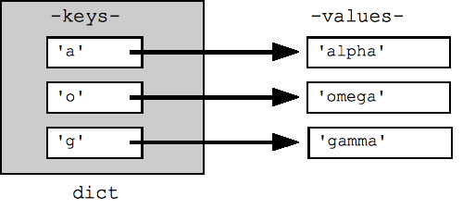
Plan for today
Tuples
Dictionaries
*Text analysis
* If time permits

Slide 6
Mutable vs. Immutable
Lists are mutable
This is legal:
>>> my_list = [1, 2, 3, 4, 5]
>>> my_list[4] = 500
Strings are immutable
This is not legal (produces an error):
>>> my_string = 'aaa'
>>> my_string[2] = 'b'

Slide 7
Tuples are immutable lists
Defined using round brackets
>>> my_list = [1, 2, 3]
>>> my_tuple = (1, 2, 3)
>>> my_tuple[0:2]
(1, 2)
>>> my_tuple[1] = 10
Traceback (most recent call last):
File "<pyshell#2>", line 1, in <module>
my_tuple[1] = 10
TypeError: 'tuple' object does not support item assignment
No append / extend / remove
in Tuples!

Slide 8
Tuples are immutable lists
A tuple is similar to a list, but it is immutable.
Syntax: note the parentheses!
>>> t = ("don't", "worry", "be", "happy") # definition
>>> t
("don't", 'worry', 'be', 'happy')
>>> t[0] # indexing
"don't"
>>> t[-1] # backwords indexing
'happy'
>>> t[1:3] # slicing
('worry', 'be')

Slide 9
Tuples are immutable lists
>>> t[0] = 'do' # try to change
Traceback (most recent call last):
File "<pyshell#2>", line 1, in <module>
t[0]='do'
TypeError: 'tuple' object does not support item assignment

Slide 10
Tuples are immutable lists
Why use Tuples?
Faster than lists in certain operations
The interpreter enforces that they are not changed, and we’ll see why this is useful.

Slide 11
Python’s types: Mutable vs. Immutable
Immutable | Mutable
Numeric types: int, float, complex | list
Tuple | dict
String | set
frozen set
None is a special type representing an absence of a value

Slide 12
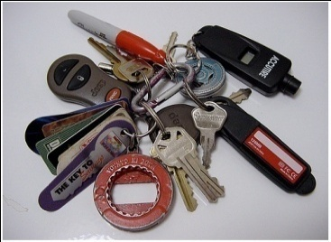









Dictionaries (Hash Tables)
keys
values
Key – Value mapping
No order guarantee
Fast!
Usage examples:
Database
Dictionary
Phone book

Slide 13
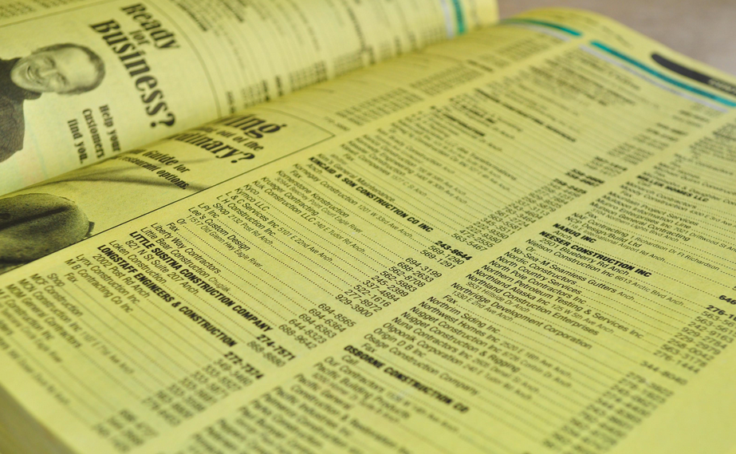
Dictionaries
Access to the data in the dictionary:
Given a key, it is easy to get the value.
Given a value, you need to go over all the dictionary to get the key.
Intuition - Yellow Pages:
Given a name, it’s easy to find the right phone number
Given a phone number it’s difficult to match the name

Slide 14
Dictionaries
Dictionary: a set of key-value pairs.
>>> dict_name = {key1:val1, key2:val2,…}
Keys are unique and immutable.

Slide 15
Dictionaries
Example: “144” - Map names to phone numbers:
>>> phonebook = {'Eric Cartman': '2020', 'Stan March': '5711', 'Kyle Broflovski': '2781'}
>>> phonebook
{'Eric Cartman': '2020', 'Stan March': '5711', 'Kyle Broflovski': '2781’}
Note: The dictionary pairs will not necessarily be presented in the same order as in the dictionary definition.
Dictionaries do not guarantee a certain key order.
Changed in version 3.7: Dictionary order is guaranteed to be insertion order. However, it’s not a good practice to rely on it because it is version/language dependent.

Slide 16
Dictionaries
Retrieve dictionary value by key:
>>> phonebook['Eric Cartman']
'2020'
Test if a key already exists in dictionary:
>>> 'Kenny McCormick‘ in phonebook
False
Add a new item:
>>> phonebook['Kenny McCormick'] = '1234'
>>> phonebook
{'Eric Cartman': '2020', 'Kyle Broflovski': '2781', 'Stan March': '5711', 'Kenny McCormick': '1234'}
{'Kyle Broflovski': '2781',
'Eric Cartman': '2020',
'Stan March': '5711'}

Slide 17
Dictionaries
What happens when we add a key that already exists?
>>> phonebook['Kenny McCormick'] = '2222'
>>> phonebook
{'Kyle Broflovski': '2781', 'Eric Cartman': '2020', 'Kenny McCormick': '2222', 'Stan March': '5711'}
Kenny’s phone was previously 1234 and now it is changed to 2222
How can we add another Kenny McCormick in the phone book?

Slide 18
Dictionaries
Idea: Add address to the key
>>> phonebook= {['Kenny McCormick', 'Southpark']: '2222'}
Traceback (most recent call last):
File "<pyshell#16>", line 1, in <module>
phonebook= {['Kenny McCormick', 'Southpark']: '2222'}
TypeError: unhashable type: 'list’
What’s the problem?
keys must be immutable!
new key

Slide 19
Dictionaries
Fix: use tuples as keys!
>>> phonebook= {('Kenny McCormick', 'Southpark'): '2222'}
>>> phonebook
{('Kenny McCormick', 'Southpark'): '2222'}

Slide 20
Dictionary Methods
Function | Description
D = {} | Creates an empty dictionary
D[k] = value | Sets D[k] to value
k in D | Returns True if k is a key in D, False otherwise
D[k] | Returns the value mapped to key k (raises KeyError if k not in D)
D.get(k, [d]) | Returns D[k] for k in D, otherwise d (default: None)
D.keys() | Returns a view* of D's keys
D.values() | Returns a view* of D's values
D.items() | Returns a view* of D’s (key, value) pairs, as 2-tuples
D.pop(k, [d]) | Removes the specified key k and returns its value. If k is not found, returns d (if d is not specified, raises KeyError)
An argument shown in [] has a default value. We don’t have to specify the second argument for get and pop methods.
* keys(), values(), items() provide iterable views in un-guaranteed order.

Slide 21
More Dictionary Methods
Function | Description
D.copy() | Returns a shallow copy of dictionary D (Only the dictionary itself is duplicated, not the objects it holds)
D.update(other) | Adds all items of dictionary other to D
Use in to test if a certain value is a key in the dictionary*.
*Same as has_key() in previous versions, as you might encounter in old exams…
Example:
>>> d = {1 : 'a'}
>>> 2 in d
False
>>> 1 in d
True
>>> 'a' in d
False
Full list of dictionary related commands: https://docs.python.org/3/library/stdtypes.html#dict

Slide 22
BONUS: Dictionary Views (New in 3.7)
The dictionary methods keys(), values(), items() return a dynamic iterable view.
Starting from python 3.7 dictionaries and their views are returned in insertion order, but do not assume this (because it is version/language dependent).
A view can be iterated using a loop, tested for membership using in and it dynamically changes as the dictionary changes.
Do not change the dictionary while iterating one of its views.
>>> d={'A':65, 'B':66, 'C':67}
>>> d
{'A': 65, 'B': 66, 'C': 67}
>>> d.keys()
dict_keys(['A', 'B', 'C'])
>>> d.values()
dict_values([65, 66, 67])
>>> a=d.items()
>>> a
dict_items([('A', 65), ('B', 66), ('C', 67)])
>>> d['D']=68
>>> a # changed automatically as d changed !
dict_items([('A', 65), ('B', 66), ('C', 67), ('D', 68)])
>>> for k in d.keys():
print (k, end= ' ')
A B C D
>>> 'E' in d.keys()
False

Slide 23
Example: Frequency Counter
Assume you want to learn about the frequencies of English letters usage in text.
You find a long and representative text and start counting.
s u p e r c a l i f r a g i l i s t i c e x p i a l i d o c i o u s

Slide 24
Frequency Counter
text = 'supercalifragilisticexpialidocious'
# count letters – build letters histogram
def get_char_count(text):
char_count = {}
for char in text:
if not char in char_count:
char_count[char] = 1
else:
char_count[char] = char_count[char] + 1
return char_count

Slide 25
Frequency Counter (get(k,0) version)
text = 'supercalifragilisticexpialidocious'
# count letters – build letters histogram
def get_char_count(text):
char_count = {}
for char in text:
count = char_count.get(char, 0)
count += 1
char_count[char] = count
return char_count
# a shorter version:
for char in text:
char_count[char] = char_count.get(char, 0) + 1

Slide 26
Frequency Counter
In what order can we print the counts?
1. We can print the results in an alphabetic order: print the count for 'a', then 'b' and so on.
2. We can print the results ordered by the counts: start from the most frequent letter and finish with the least frequent
Sort by the keys
Sort by the values

Slide 27
Print by keys order
def print_by_keys_order(char_count):
chars = char_count.keys()
sorted_chars = sorted(chars)
for char in sorted_chars:
print(char, ':', char_count[char])
text = 'supercalifragilisticexpialidocious'
cc = get_char_count(text)
print_by_keys_order(cc)
Iterable view containing the
dictionary’s keys
Creates a sorted list of the dictionary’s keys
The output is:
a : 3
c : 3
d : 1
e : 2
f : 1
…

Slide 28
Print by values order
# text = 'supercalifragilisticexpialidocious'
def print_by_values_order(char_count):
chars = char_count.keys()
sorted_chars = sorted(chars, key=char_count.get, reverse=True)
for char in sorted_chars:
print(char , ':', char_count[char])
The output is:
i : 7
a : 3
c : 3
l : 3
s : 3
…

Slide 29
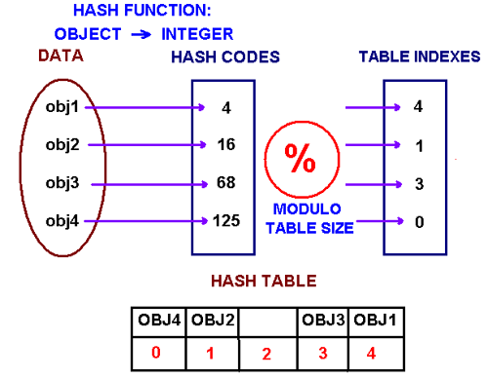
More about dictionaries… Hash Functions
The type for a dictionary keys must be
Immutable
Hashable

Slide 30
More about dictionaries… Sorting Dictionaries
http://pythoncentral.io/how-to-sort-python-dictionaries-by-key-or-value/
numbers = {'first' : 1, 'second' : 2, 'third' : 3, 'fourth' : 4}
Printing keys+values sorted by keys
for key in sorted(numbers.keys()):
print(key + ": ", numbers[key])
first: 1
fourth: 4
second: 2
third: 3

Slide 31
More about dictionaries… Sorting Dictionaries
http://pythoncentral.io/how-to-sort-python-dictionaries-by-key-or-value/
numbers = {'first' : 1, 'second' : 2, 'third' : 3, 'fourth' : 4}
Printing the keys sorted by values
# Use the get method as the key function
>>> sorted(numbers, key = numbers.get)
# In the order of sorted values: [1, 2, 3, 4]
['first', 'second', 'third', 'fourth']
Printing the keys sorted by values, in reverse
>>> sorted(numbers, key = numbers.get, reverse = True)
['fourth', 'third', 'second', 'first']

Slide 32
More about dictionaries… Sorting Dictionaries
http://pythoncentral.io/how-to-sort-python-dictionaries-by-key-or-value/
List comprehension is a natural way to generate a list:
>>> S = [x**2 for x in range(10)]
>>> S
[0, 1, 4, 9, 16, 25, 36, 49, 64, 81]
Sorts the keys
alphabetically!
(and returns the reversed order)
Useful for dictionaries too:
numbers = {'first' : 1, 'second' : 2, 'third' : 3, 'fourth' : 4}
>>> [value for (key, value) in sorted(numbers.items(), reverse=True)]
[3, 2, 4, 1]

Slide 33
BONUS Example: Identifying frequent words in text
Steps:
Find textual data of interest
Collect word statistics
Analyze the results

Slide 34
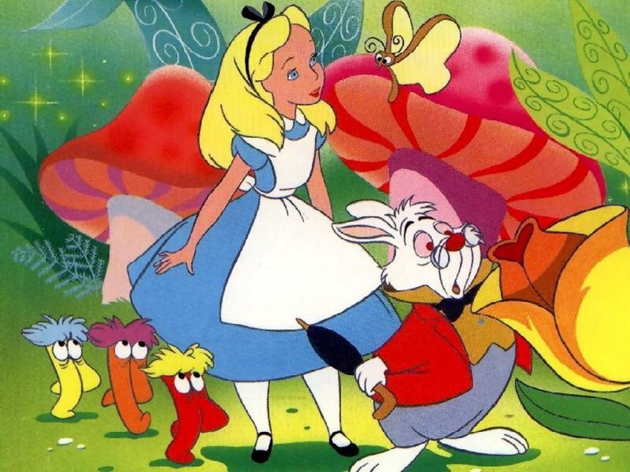
Reading an online text using Python
import urllib.request
url=urllib.request.urlopen('https://raw.githubusercontent.com/GITenberg/Alice-s-Adventures-in-Wonderland_11/master/11.txt')
alice= url.read().decode()
convert from one encoding scheme
to the desired encoding scheme.
URL = uniform resource locator. A web-address, which is a string that constitutes a reference to a web resource
Try:
urllib.request.urlopen('http://www.google.com').read().decode()

Slide 35
Print Most Popular Words
(High Level)
Import urllib.request
def main():
alice = urllib.request.urlopen('https://raw.githubusercontent….’)
n = 30
print_most_popular(alice, n, 'Alice In Wonderland')
print_most_popular:
Input:
a url address url,
an integer n,
a string book_name
The function reads the text, finds the top n most popular words and prints the book name and the popular words.

Slide 36
Modular Programming
Top-down approach: first write what you plan to do and then implement the details
Clear for readers
Easy to debug and test
Easy to maintain

Slide 37



Print most popular words - Plan
Split the given text into words
Count occurrences in text for each word using a dictionary
For a given n: return the n most popular words.
What are the 3 most frequent words in the text ?
Sorting words by counts can help:
w9 | w8 | w5 | w4 | w3 | w2 | w1 | Word
15 | 42 | 23 | 1 | 4 | 16 | 8 | Count
42 23 16 15 8 4 1
Observation: the 3 most frequent words are the first 3 ones after sorting by values in reverse (descending) order

Slide 38
PrintMostPopular
Build Word-Occurrences Dictionary
def print_most_popular(url, n, book_name):
'''url – object representing an internet address (URL)
n - num of popular words to print
bookName - name of book
'''
text = url.read().decode()
words = text.split()
string.split() – returns a list. Splits the string by whitespaces
>>> text = 'Hello world, 2019!'
>>> text.split()
['Hello', 'world,', '2019!']

Slide 39
PrintMostPopular
Build Word-Occurrences Dictionary
def print_most_popular(url,n, book_name):
'''url - object representing an internet address (URL)
n - num of popular words to print
bookName - name of book
'''
text = url.read().decode()
words = text.split()
word_count = {}
for w in words:
word_count[w] = word_count.get(w, 0) + 1
word_count holds the counts for each word

Slide 40
PrintMostPopular
Build Word-Occurrences Dictionary
def print_most_popular(url,n, book_name):
'''url - object representing an internet address (URL)
n - num of popular words to print
bookName - name of book
‘‘’
text = url.read().decode()
words = text.split()
word_count = {}
for w in words:
word_count[w] = word_count.get(w, 0) + 1
sorted_words = sorted(word_count, key=word_count.get, reverse=True)
top_n_words = sorted_words[:n]

Slide 41
PrintMostPopular
Build Word-Occurrences Dictionary
def print_most_popular(url,n, book_name):
'''url - object representing an internet address (URL)
n - num of popular words to print
bookName - name of book
'''
text = url.read().decode()
words = text.split()
word_count = {}
for w in words:
word_count[w] = word_count.get(w, 0)+1
sorted_words = sorted(word_count, key=word_count.get , reverse=True)
top_n_words = sorted_words[:n]
print('*****', book_name, '*****')
for word in top_n_words:
print((word, word_count[word])) #print as tuples

Slide 42
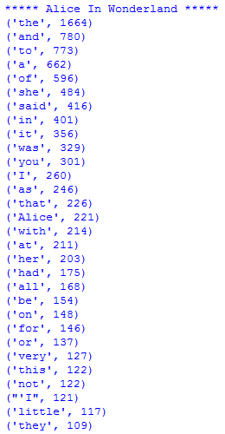
Results

Slide 43
How is it Really Done?
Preprocessing (e.g., words to lower case, remove punctuation signs)
Enhance statistics
Discard stop words (e.g., and, of, a)
Stemming (e.g., go & went)
Synonyms (מילים נרדפות)
Entity recognition (e.g., N.Y.C)

